Slide 1
Theory of Automata
Lecture # 15-16

Slide 2
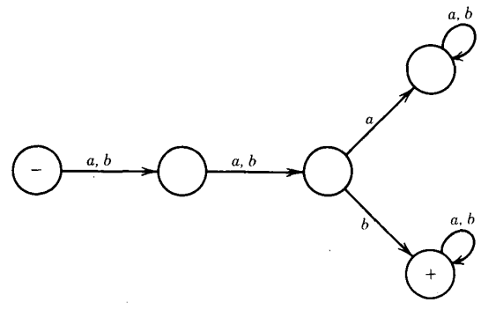
FA Accepts what?

Slide 3


FA Accepts……

Slide 4
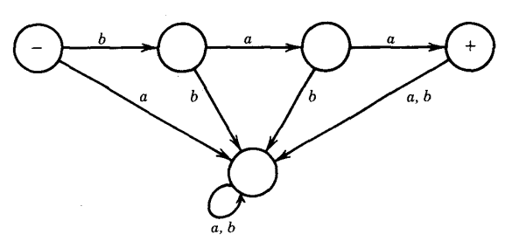
FA Accepts what?

Slide 5


FA Accepts……

Slide 6
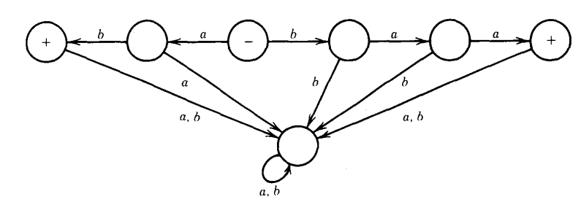
FA Accepts what?

Slide 7
FA Accepts……
The FA below accepts exactly the two strings
baa and
ab

Slide 8
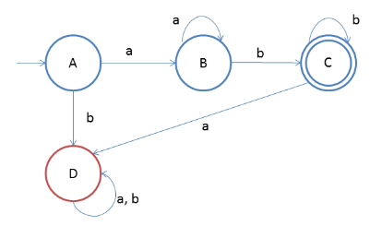
Design a DFA such that: L = {a^{n}b^{m} | n,m ≥ 1} Given: Input alphabet, Σ={a, b}
Notes:
L={a^n .b^m .c^p | n,m,p >=1}
…………………………………………………
n=1, m=1
L=ab
n=2, m=2
L=aabb
n=1, m=2
L=abb
n=2, m=1
L=aab

Slide 9
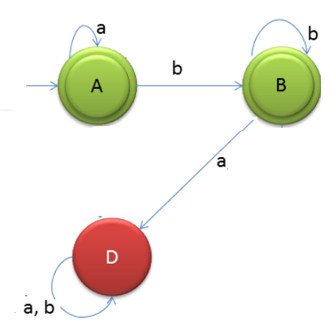
Design a DFA such that: L = {a^{n}b^{m} | n,m ≥ 0} Given: Input alphabet, Σ={a, b}
Notes:
L={} =^
L= b ; n=0, m=1
L= ab ;n=1, m=1
……………………………………………
L={a^n. b^m,c^p ; n,m,p >=0}

Slide 10
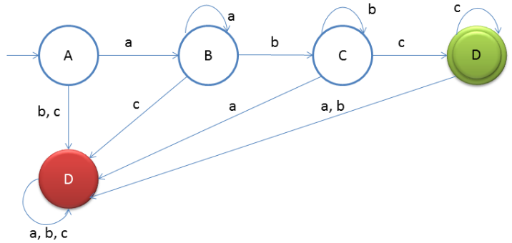
Design a DFA such that: L = {a^{n}b^{m}c^{l} | n,m,l ≥ 1} Given: Input alphabet, Σ={a, b, c}

Slide 11
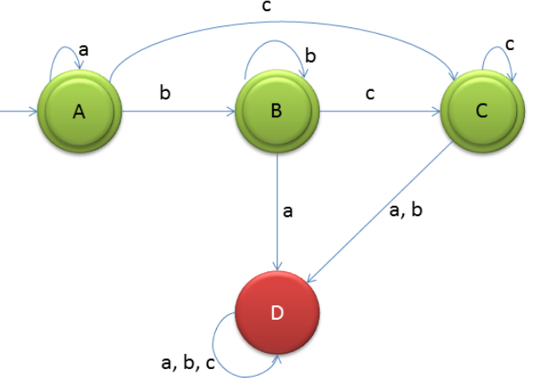
Design a DFA such that: L = {a^{n}b^{m}c^{l} | n,m,l ≥ 0} Given: Input alphabet, Σ={a, b, c}

Slide 12
FA With Output- Moore Machine
Moore machine M is the 5 tuple M= (Q, A, O, T, F, s) where
Q is a finite set of states
A is the finite input alphabet
O is the finite output alphabet
T is the transition function
F is the output function Q A
in addition to the start state or the initial state

Slide 13
FA With Output- Moore Machine
Moore Machine
A Moore machine is very similar to a Finite Automaton(FA), with a few key differences:
It has no final states.
It does not accept or reject input, instead, it generates output from input.
Moore machines cannot have nondeterministic states.

Slide 14
FA With Output- Moore Machine
Every input gives output
In each state we stop we print out what inside that state (it's content)
This machine might be considered as a "counting" machine

Slide 15
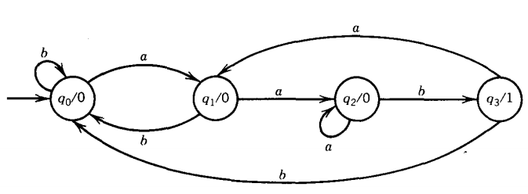
FA With Output- Moore Machine

Slide 16
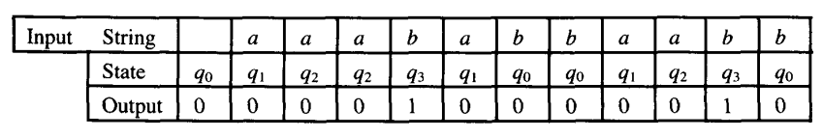
FA With Output- Moore Machine

Slide 17
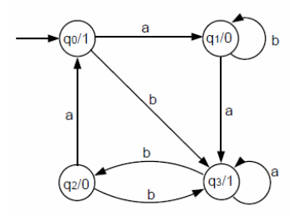
FA With Output- Moore Machine
Input: a a a b b b b
Output: 1 0 1 1 0 1 0 1

Slide 18
FA With Output- Mealy Machine
Mealy machine M is a 5 tuple M= (Q, A, O, T, F ,s) where
Q is a finite set of states
A is the finite input alphabet
O is the finite output alphabet
T is the transition function
F is the output function Q A
in addition to the start state or the initial state

Slide 19
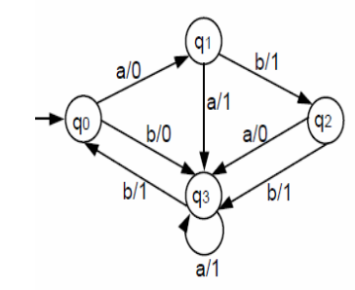
FA With Output- Mealy Machine
output on edge
same number of input to output
Input: a a a b b
Output: 0 1 1 1 0

Slide 20
FA With Output- Mealy Machine
Mealy machines are finite-state machines that act as transducers or translators, taking a string on an input alphabet and producing a string of equal length on an output alphabet.
Mealy machine does not accept or reject an input string

Slide 21
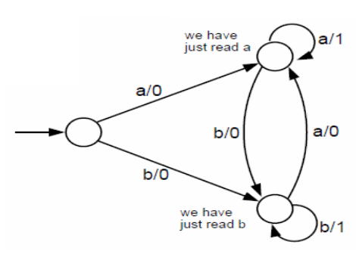
FA With Output- Mealy Machine
Input: a a a b b b
Output: 0 1 1 0 1 1
Input: ababbaab
Output: 00001010
Notes:
ababbaab

Slide 22
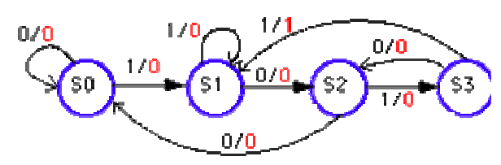
FA With Output- Mealy Machine
Input: 0 0 0 1 1 0 1 1
Output: 0 0 0 0 0 0 0 1

Slide 23
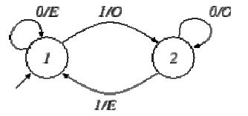
FA With Output- Mealy Machine
Example, the translation of 11100101 is OEOOOEEO.
A Mealy machine that outputs
E if the number of 1is even
O if the number of 1is odd

Slide 24
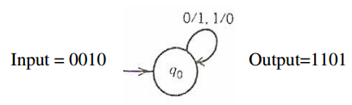
Binary inverter
The following Mealy machine takes the one's complement of its binary input. In other words, it flips each digit from a 0 to a 1 or from a 1 to a 0.

Slide 25
Note:
There are no accept states in a Moore/Mealy machine because they are not language recognizer, they are output producer.
In Mealy machine the output will be the same length as its input.
In Moore machine the output will not be of same length as its input.

Slide 26
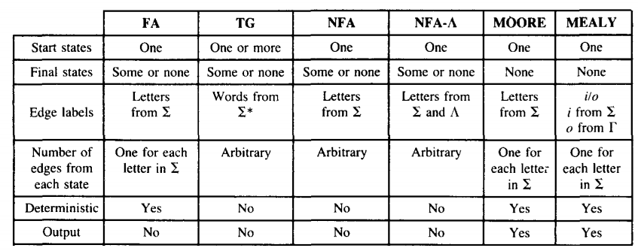
Comparison

